Slide 1
DXC REAL TIME PROJECT
NAME : S. BRAHMAIAH
Reg No: dxc262ab1228
Date: 27-06-2022

Slide 2
Projects
Smart Vehicles
AP Morgan Data Platform

Slide 3
Objective of the project
Azure Data Factory Account For Data pipelines
Create ADF Pipeline End to end pipeline with triggers enable
Create Azure blob trigger logic
Create Azure SQL Server and Database
Add another pipelines for moving data from Staging to SQL DB

Slide 4
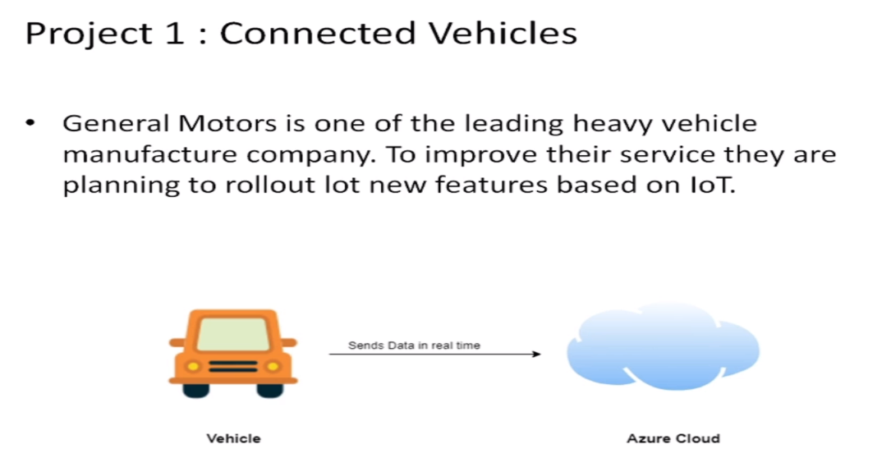

Slide 5
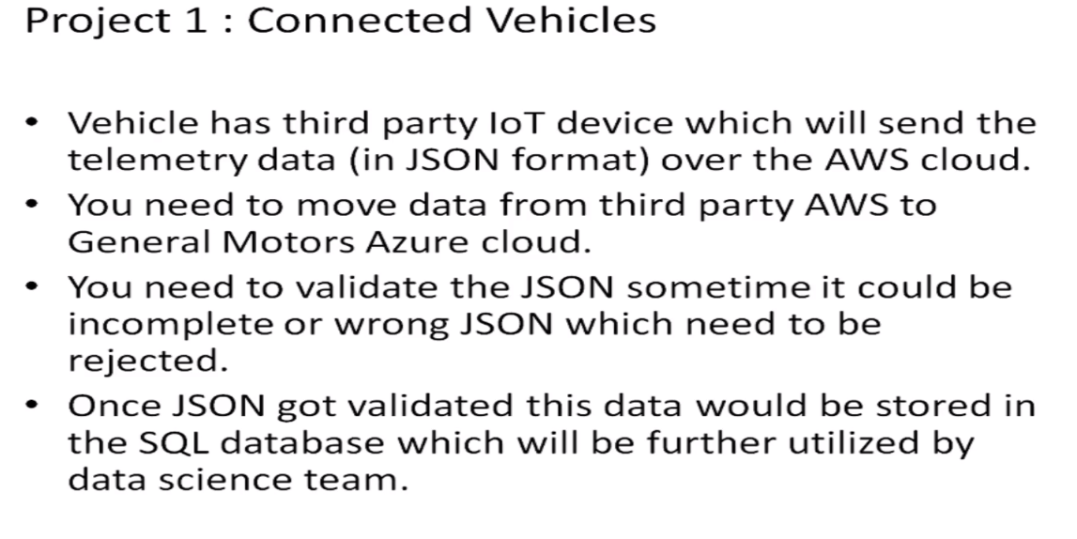

Smart Vehicles

Slide 6

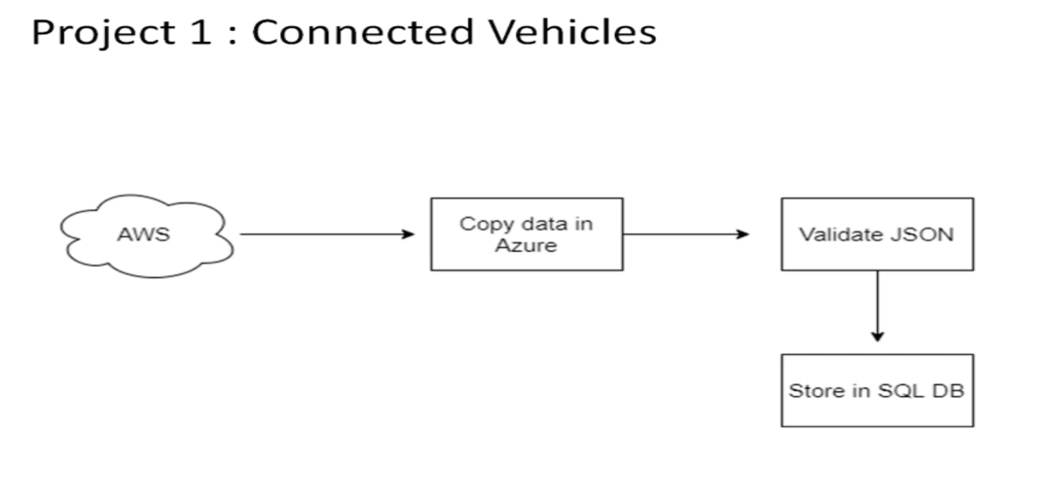
This Photo by Unknown Author is licensed under CC BY

Slide 7
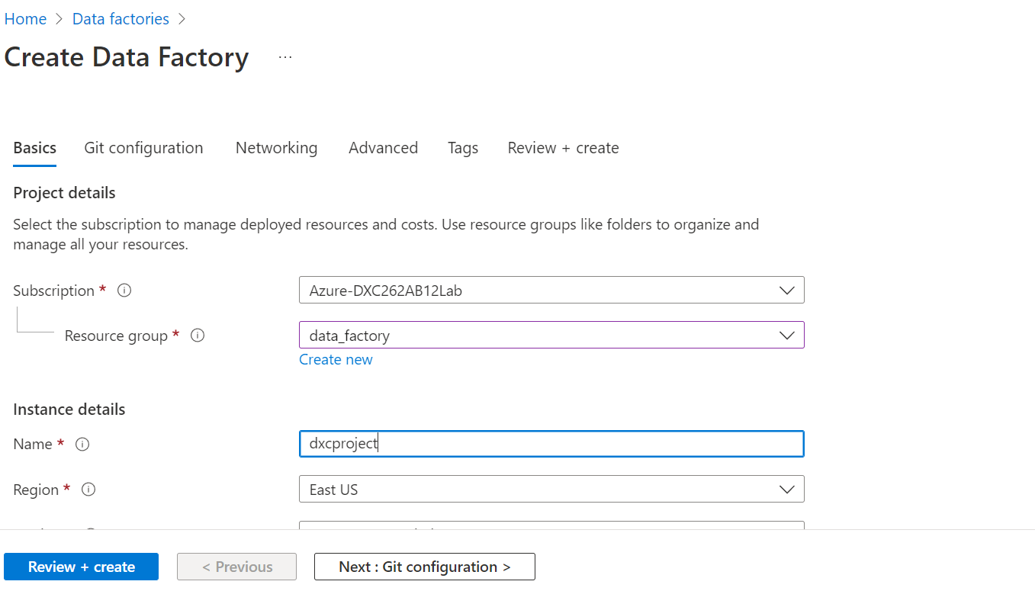
At first go to azure search for Data factory.
Create azure data factory
Fill the all required fields

Slide 8
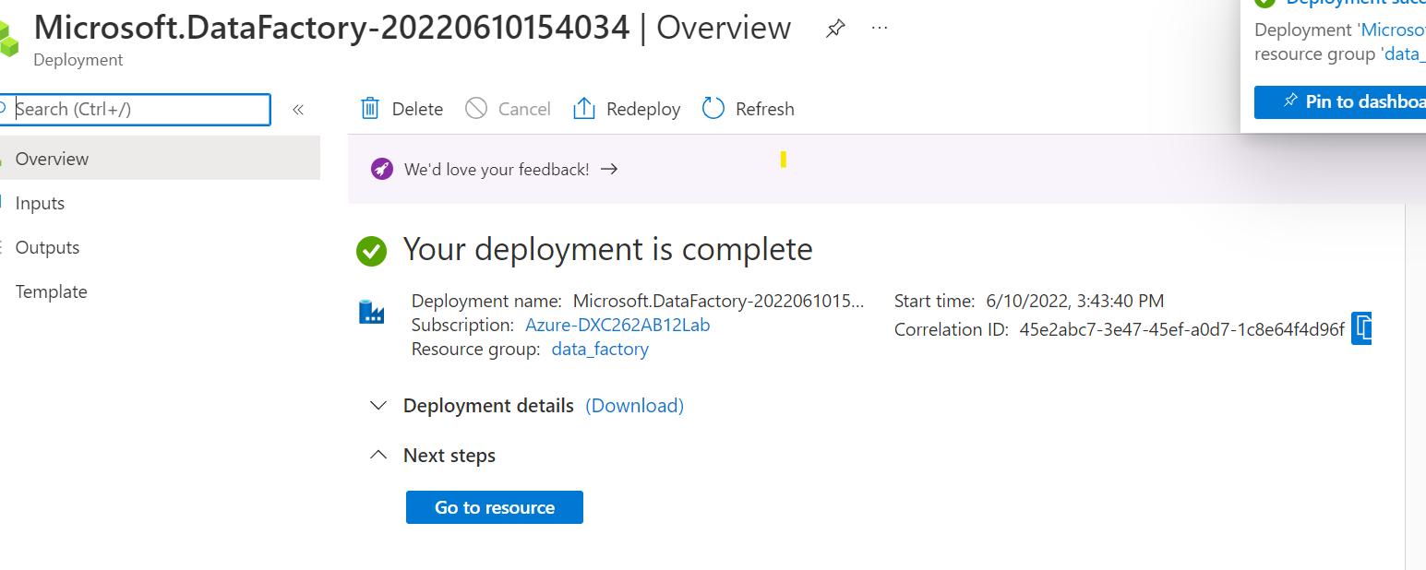
After that click on the review + create button then deployment will be come

Slide 9
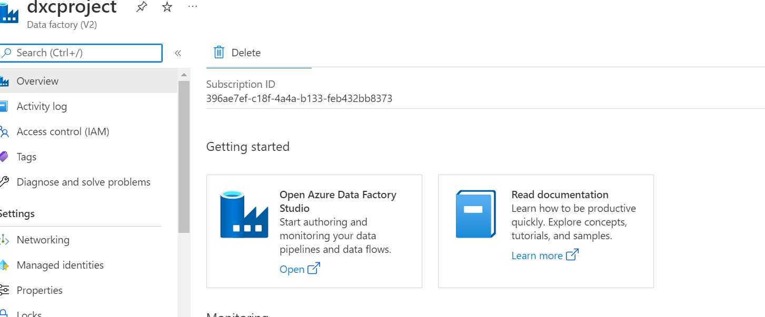
After successful creation of the deployment open the azure data factory studio.

Slide 10
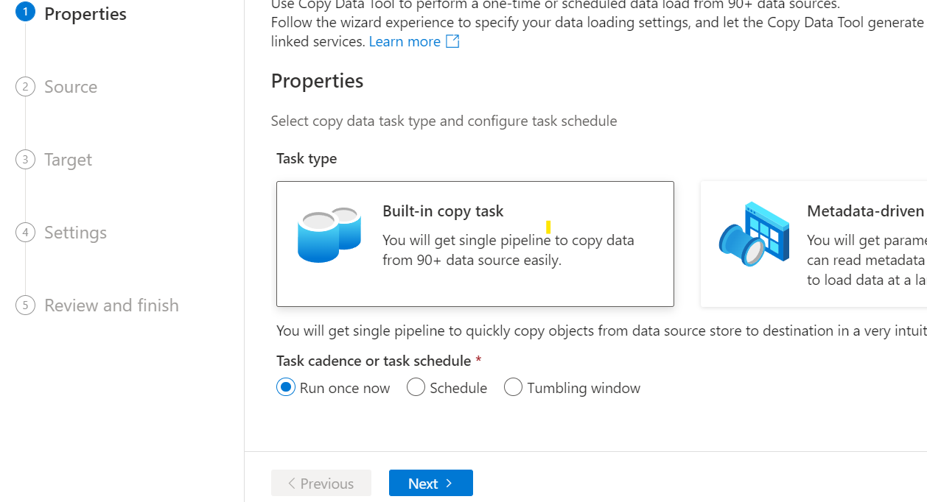
After opening of the data factory click on the built in copy task, and then click on the ‘Next’ button.

Slide 11
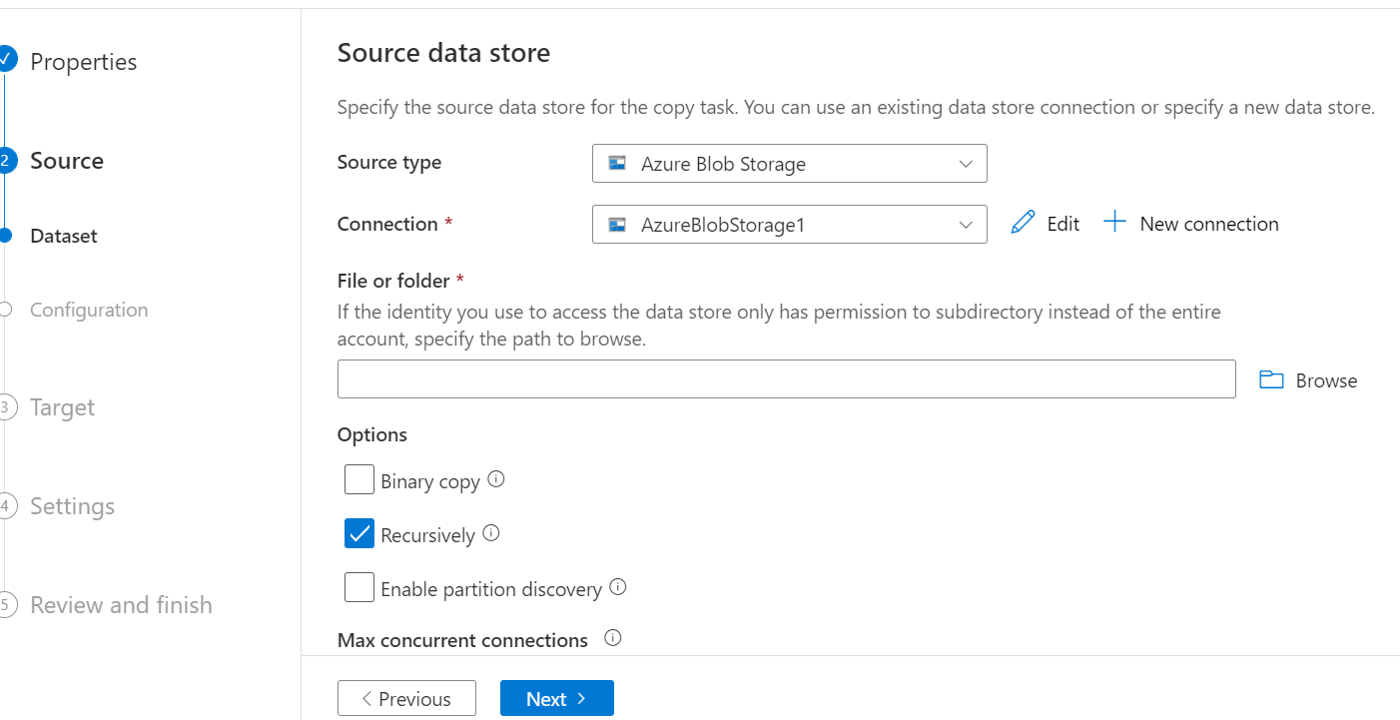
Here we have to give connection and we must choose any one file.

Slide 12
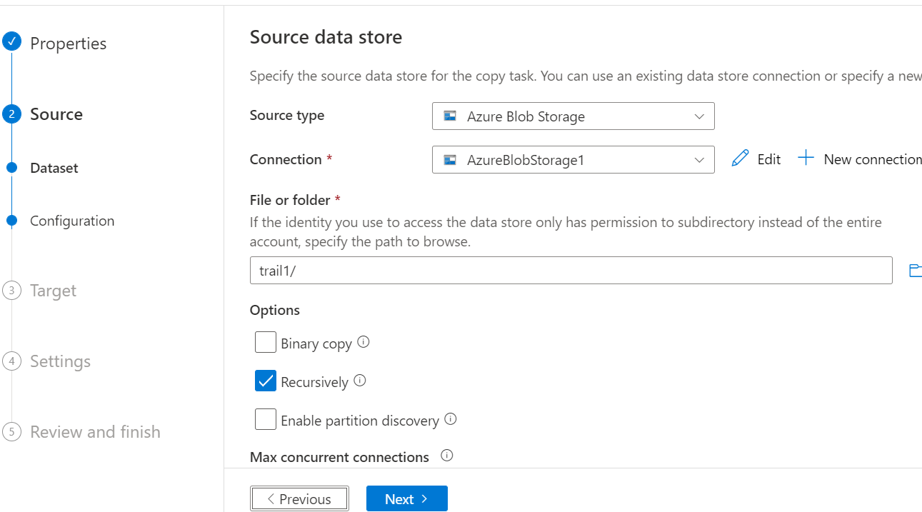
In file we have to select one file
After that click on the ‘Next’ button

Slide 13
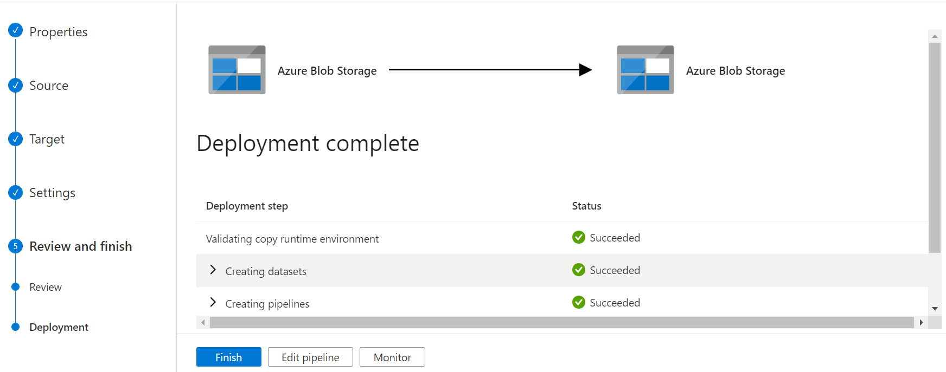
After click on the next button then pipe line will be created

Slide 14
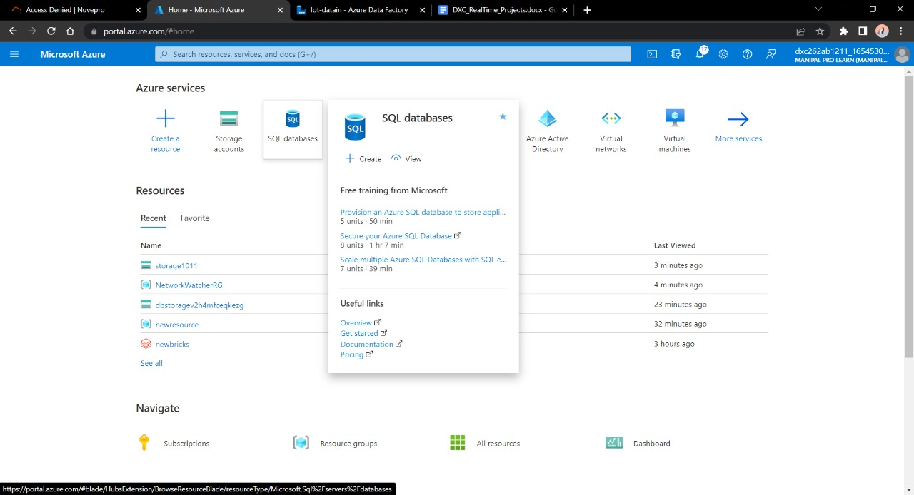
Now we need a SQL database to send the data.
For creation of the SQL DataBase follow previous steps as it is.

Slide 15
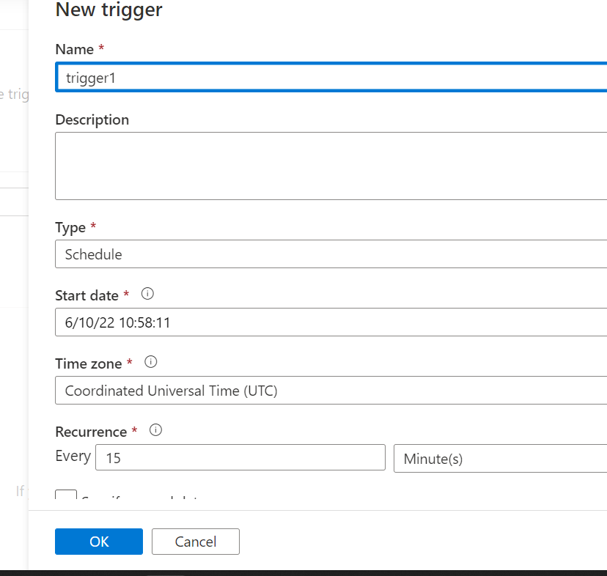
In manage we have an option to create new trigger. Create trigger from manage.
Then we can see trigger has created successfully.

Slide 16
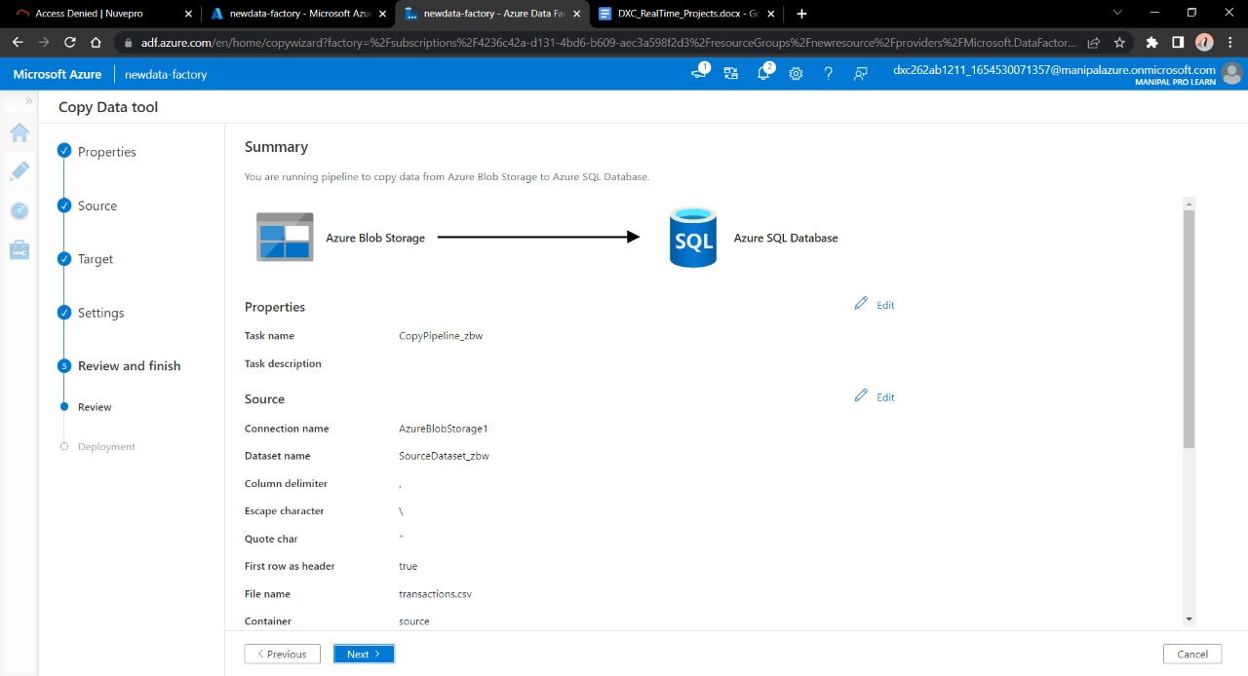
Copy the data from the blob storage to the SQL database.
Whatever the information in the blob storage appeared in the database.

Slide 17
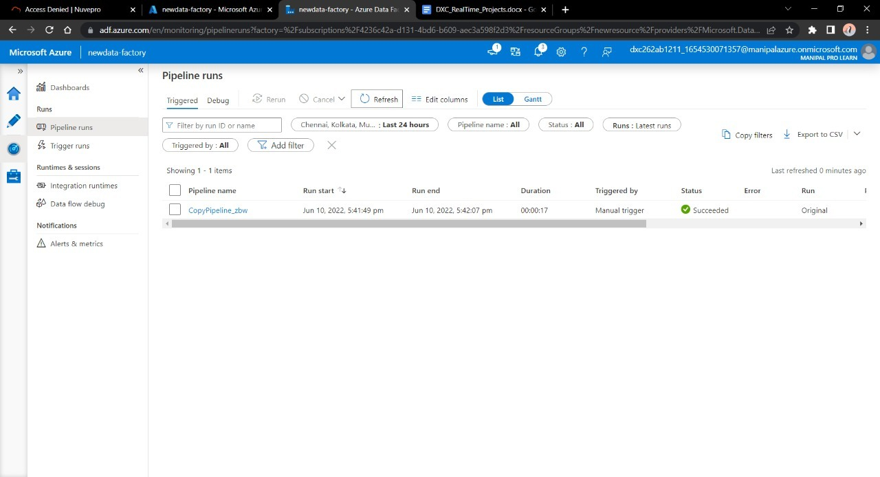
Now here we can see pipe is successfully running of the manually created trigger.

Slide 18
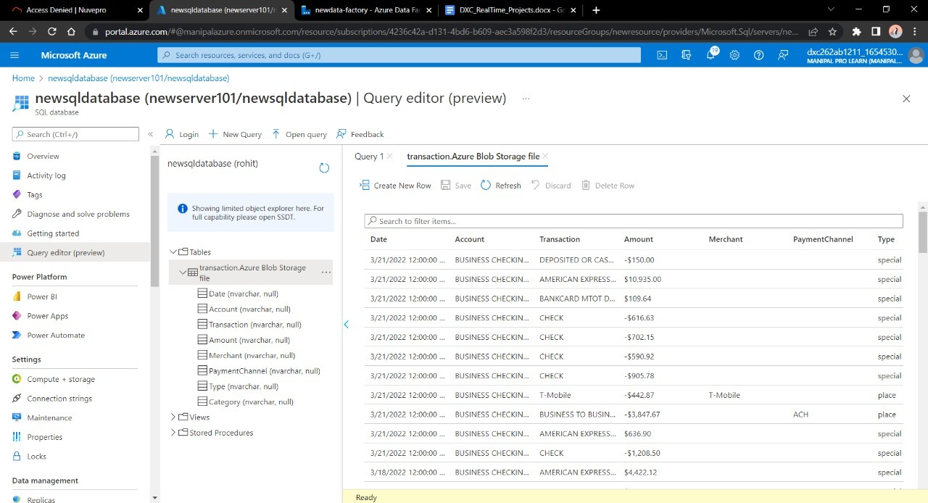
Navigate towards SQL database in order to check the data.
Here we can see successful running of the pipelines

Slide 19
Result:
Here we are successfully created the pipeline that will copy the will validate and copy the blob data into SQL database.

Slide 20
Project2 : AP Morgan Data Platform

Slide 21
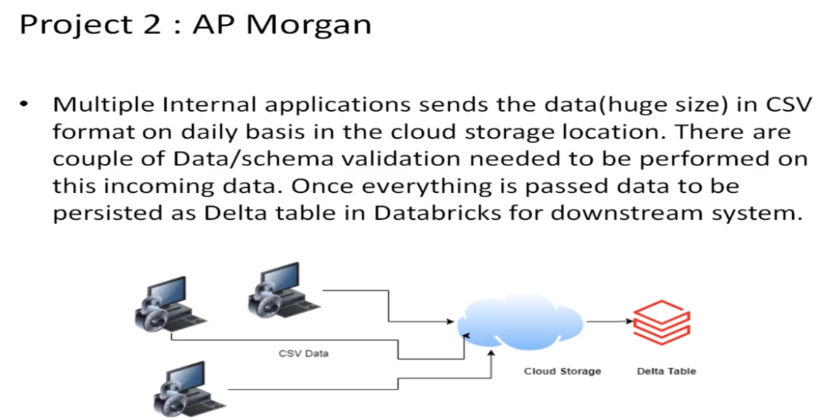

Slide 22
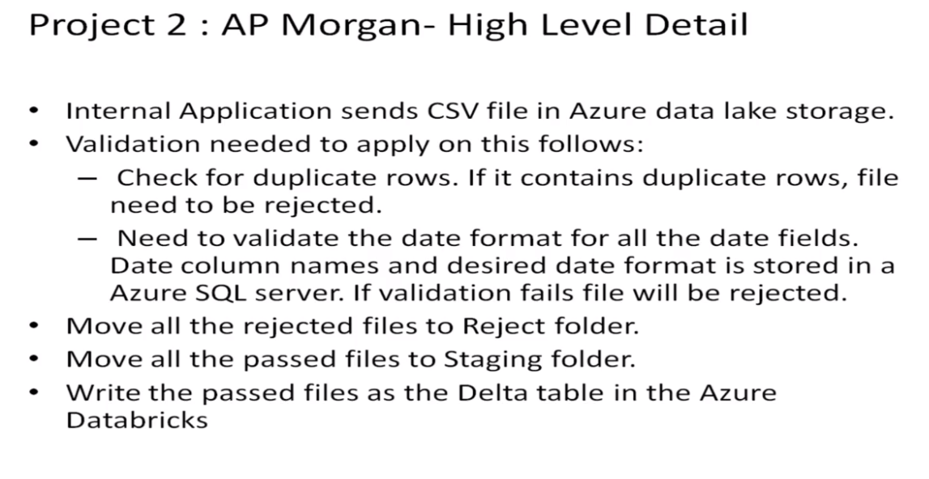

Slide 23
Objective of the project
Create a Databricks
Create Cluster in Azure Databricks
Add notebook in Databricks and implement the business logic
Azure Data Factory for AP Morgan
Create Azure Databricks linked service in ADF

Slide 24
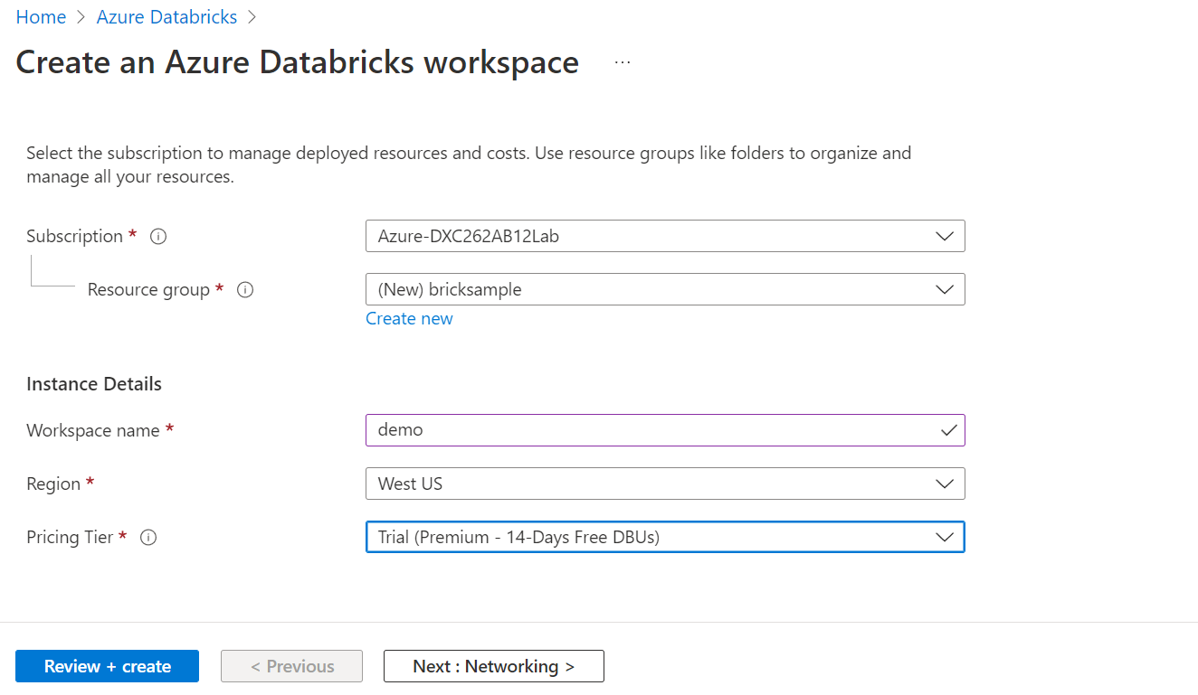
At first go to data bricks and create work space for data brick.
And create the data brick work space in the azure and fill the all required fields.

Slide 25
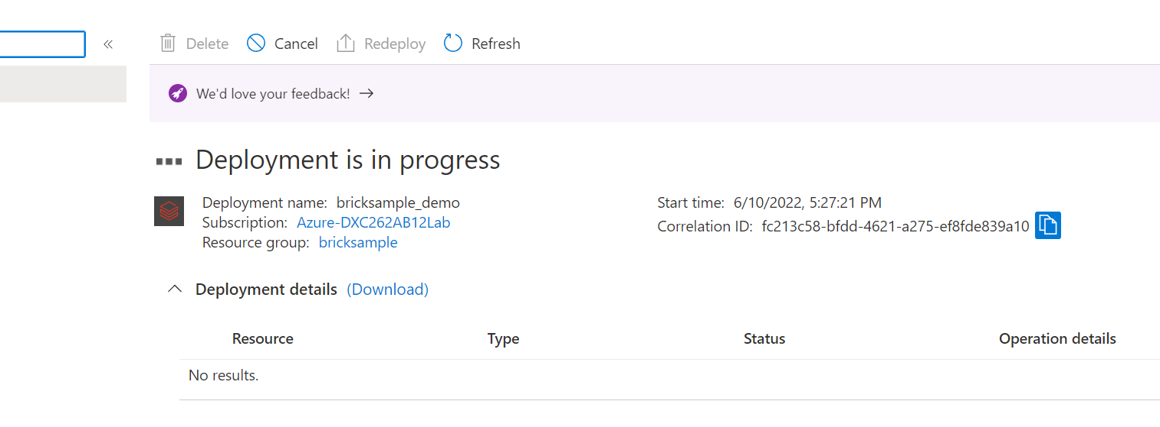
After click on the review+ create deployment will be started .

Slide 26
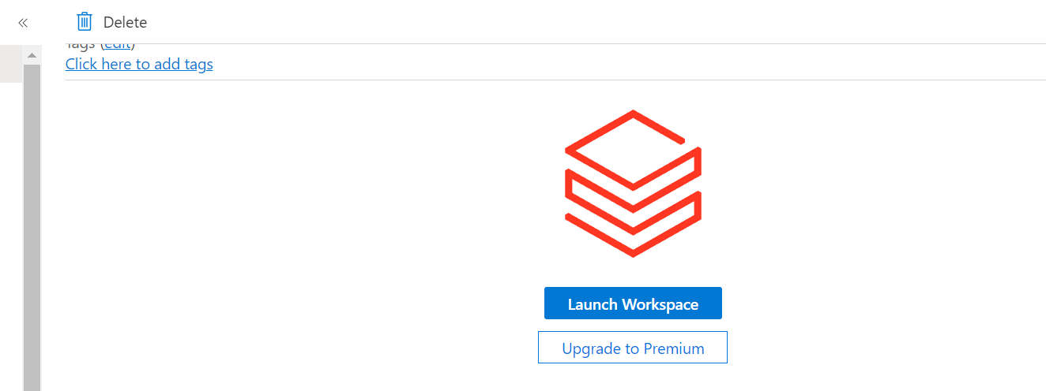
After completion of the deployment then click on the launch workspace.
After that it will asking for any Microsoft account.
Then choose any one Microsoft account.

Slide 27
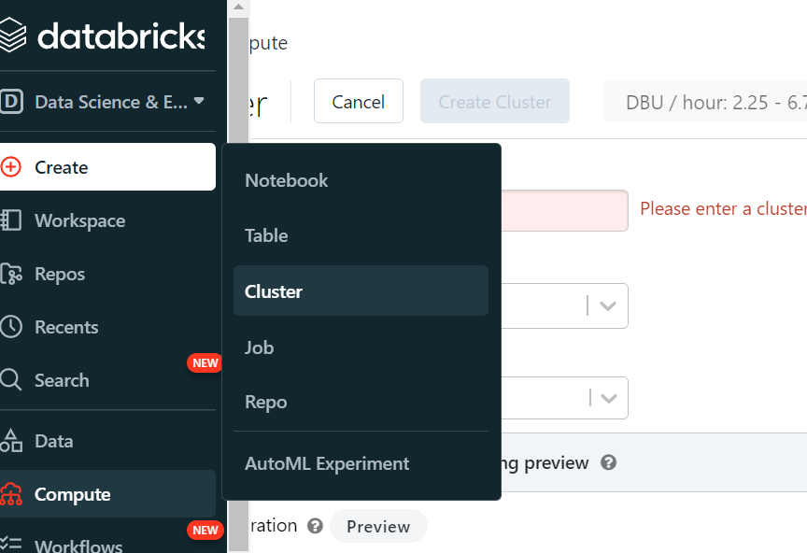
In data bricks click on create >cluster
Creation of the cluster we have to give the some information.

Slide 28
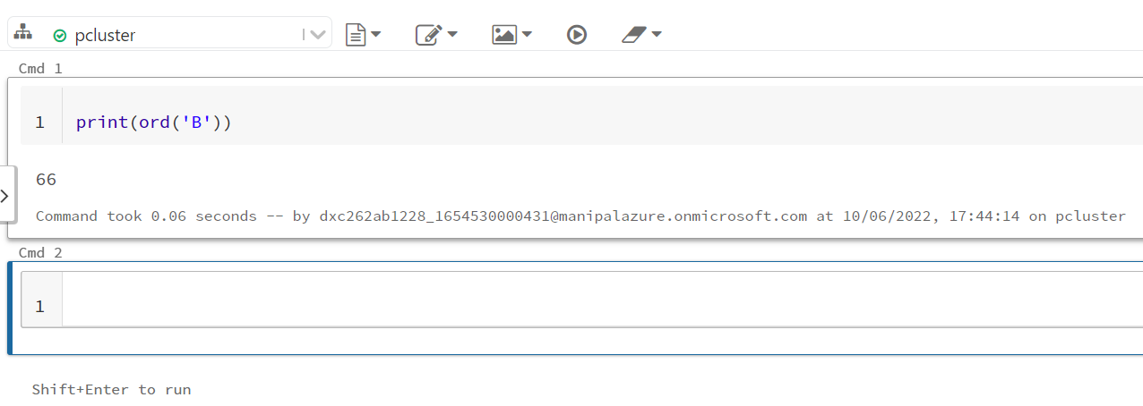
After creation of the cluster click on the note book instead of the cluster and give any name to it.
In the notebook we have to write some python code
And run the written code.

Slide 29
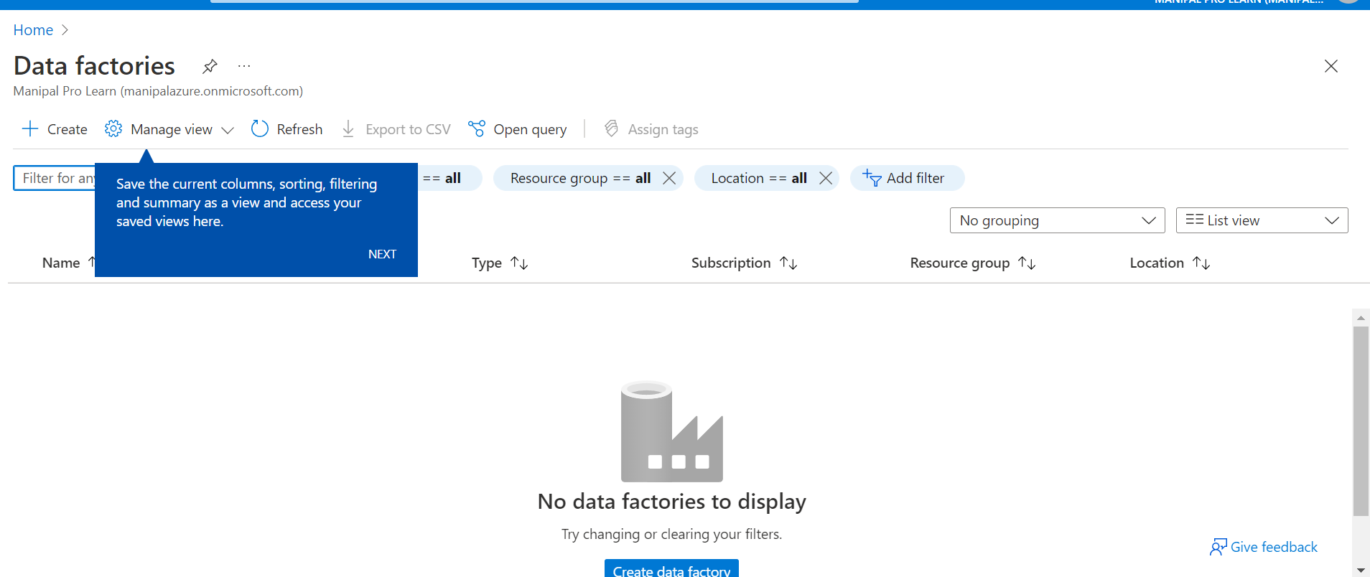
Create azure data factory by clicking on the create button.
For the creation of ADF follow the previous steps whatever we followed before

Slide 30
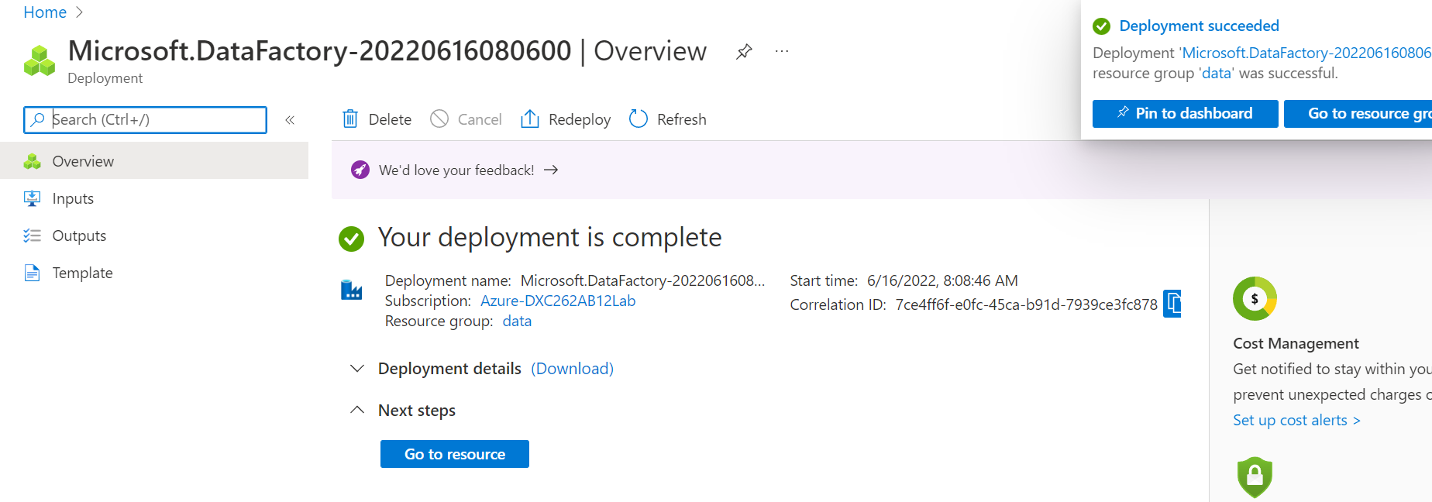
After completion of the validation deployment will be created.
Then click on go to resources.

Slide 31
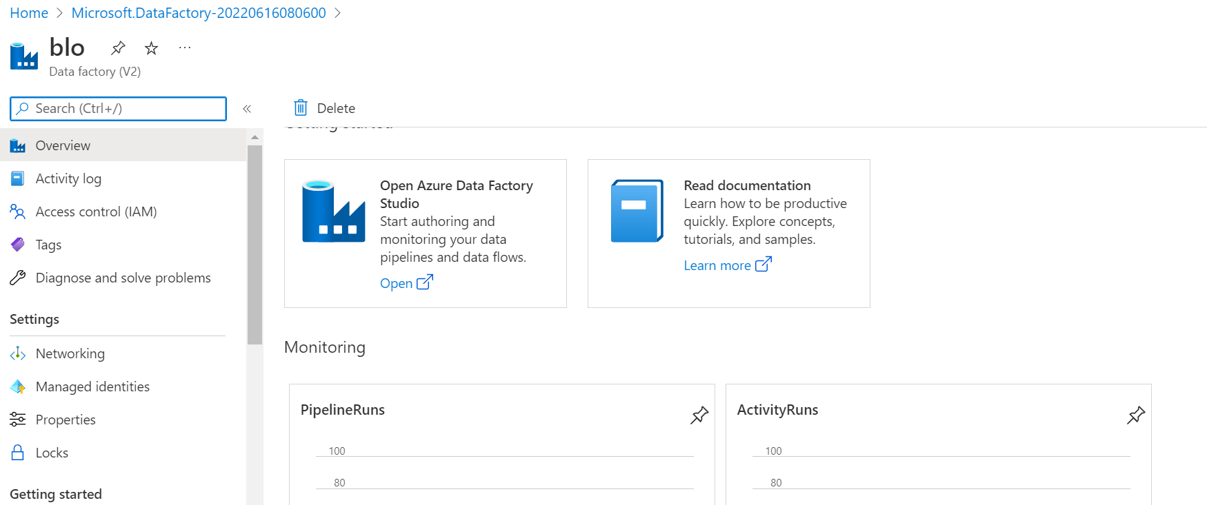
Now data factory studio will come.
Open the Azure Data Factory

Slide 32
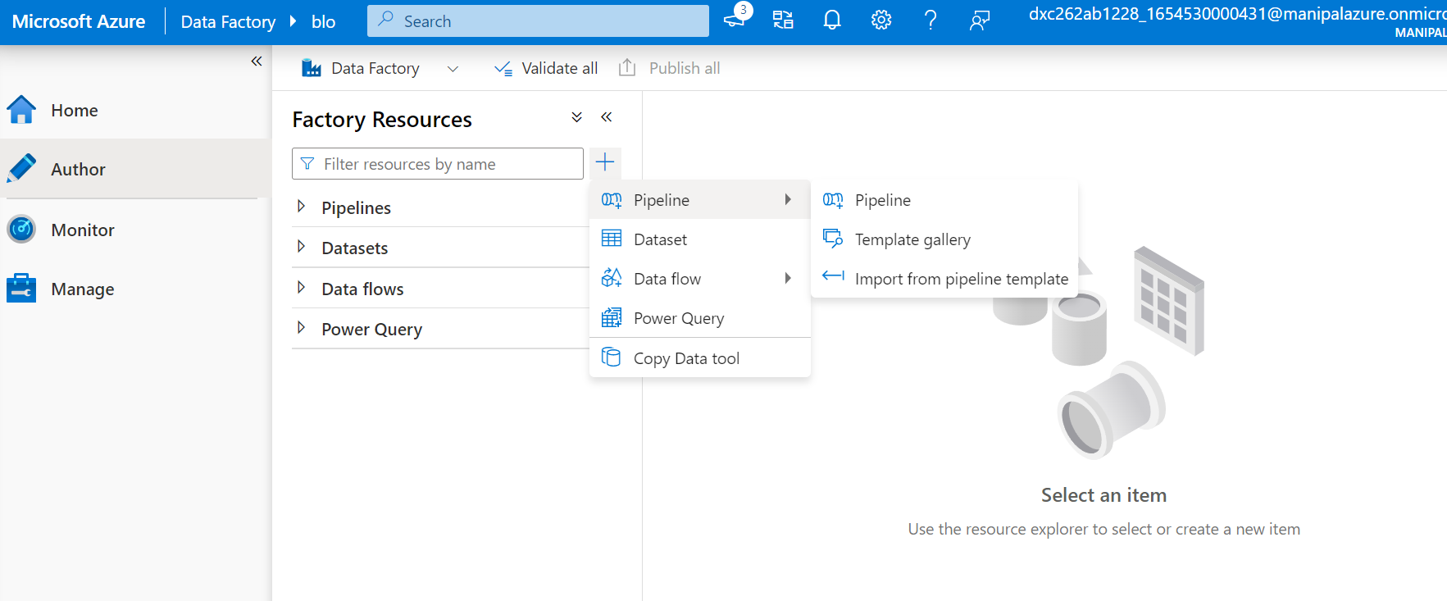
Here we need to create the pipe line
Pipe line helps to connect the data bricks note book.

Slide 33
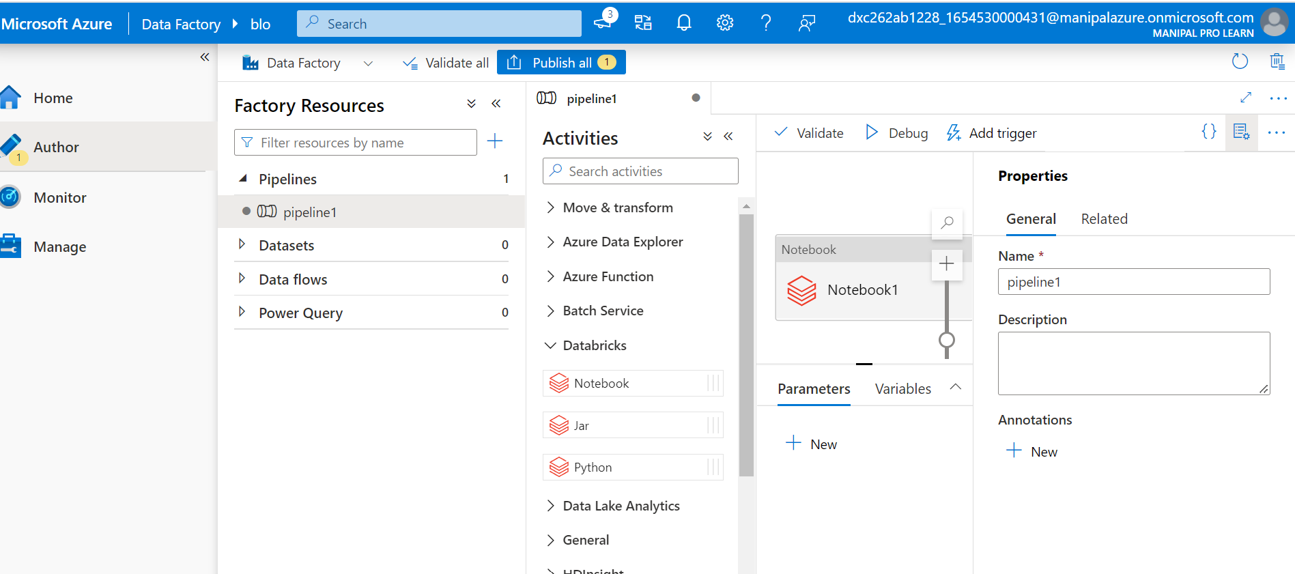
From the data bricks drag and drop the note book which is already created in the data bricks.

Slide 34
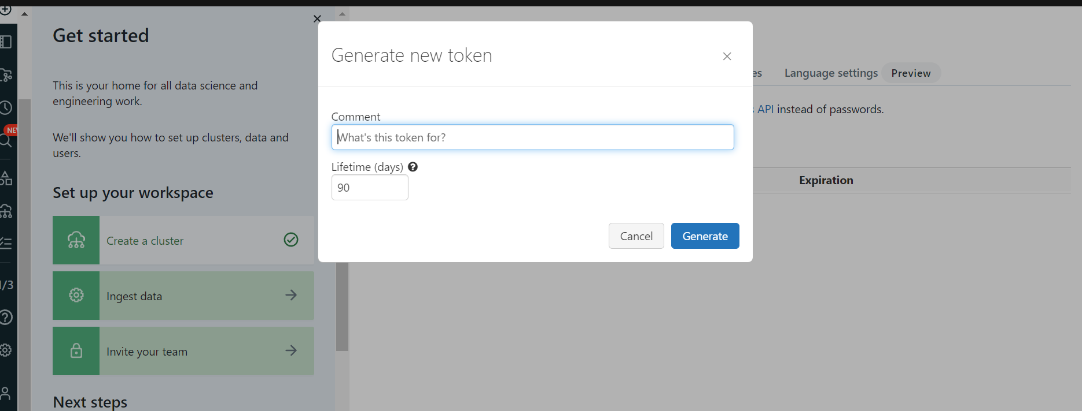
Generate the new access token and give the name for the converter.
In the linked services give the all required fields with the access token.

Slide 35
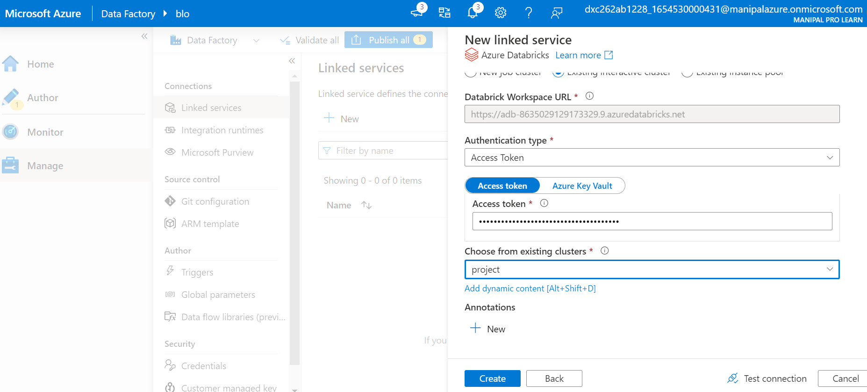
Create the new linked services and give the all required fields along with the access token.

Slide 36
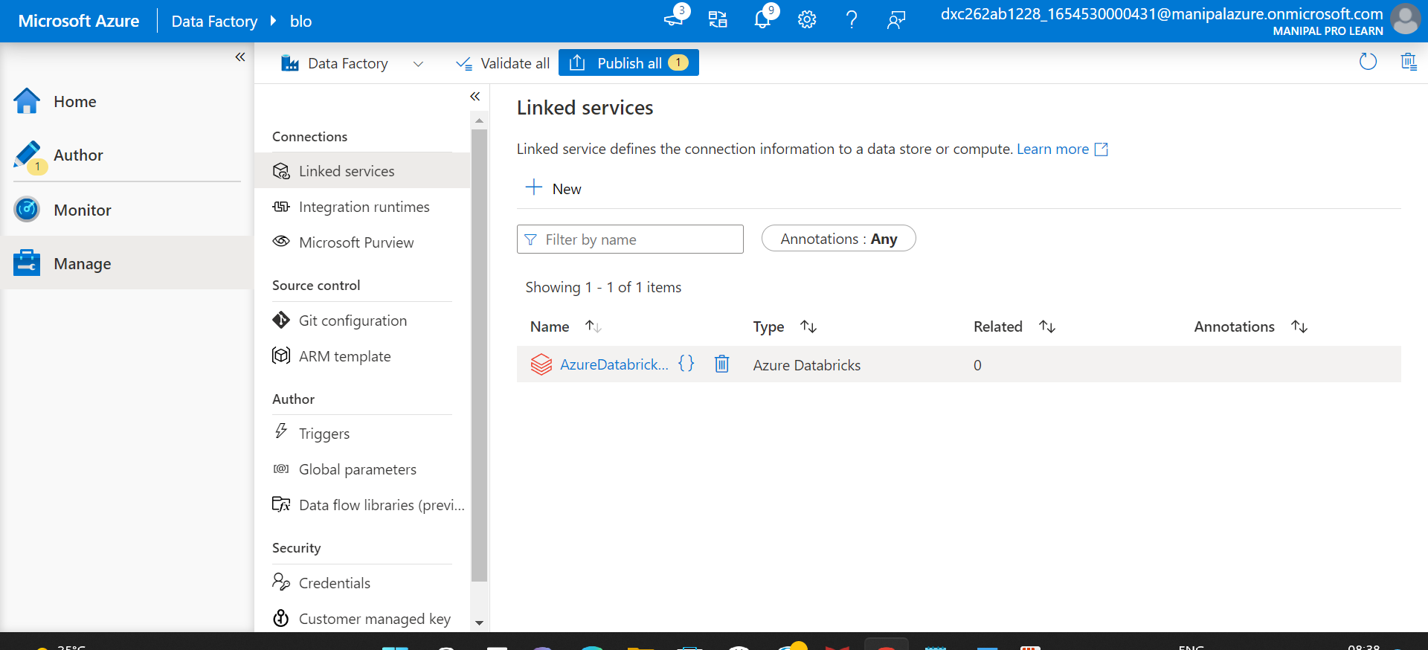
After creating the linked service

Slide 37
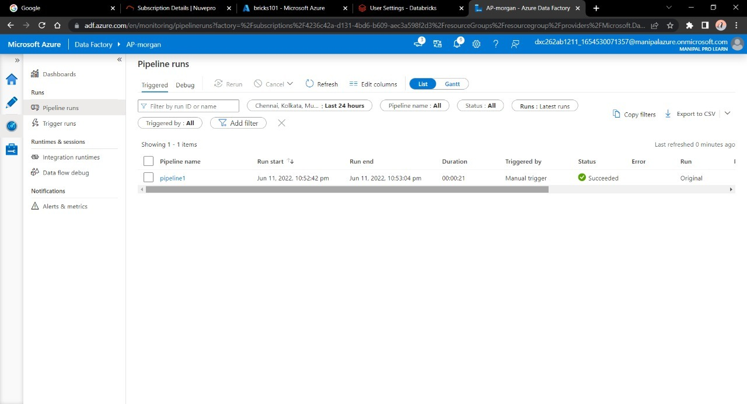
Go to monitor window in order to check it’s execution.

Slide 38
Result
Successfully able to link the azure data brick notebook using data factory

Slide 39
THANK YOU

